Slide 1
Data Security in Cloud Computing Based on Homomorphic Encryption – Advanced Secret Sharing-Key Management Scheme
Ashwath S
Balasubramaniam T
Karthik Raj A
Guide : Prabakeran Saravanan

Slide 2
Agenda
Abstract
Introduction
Literature Survey
Proposed Technique
Proposed Architecture
Modules
Conclusion and Result
References

Slide 3
Abstract
Cloud is globally used and has no borders.
It’s features attracts organizations to use cloud storage.
Data security stands as one of it’s major
issues.
Use of internet in cloud reduces data control.
The proposed technique provides better security solutions against attacks and failures.

Slide 4
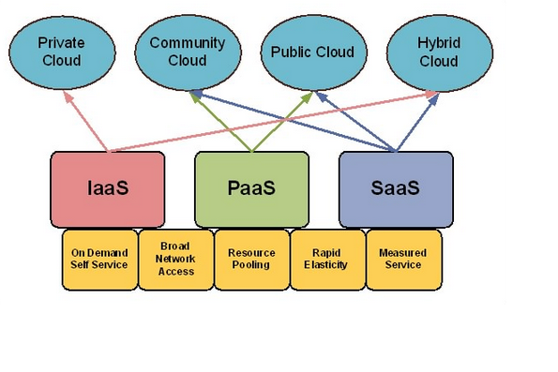
Introduction
Cloud is virtual environment for data processing.
Cloud computing provide convenient & on– demand network access to shared resources.
Eg: Yahoo, Gmail, Hotmail etc.
Types of Cloud computing:
Deployment model
Service model

Slide 5
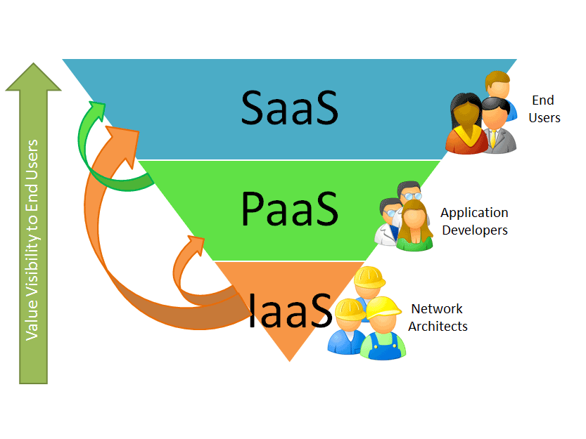
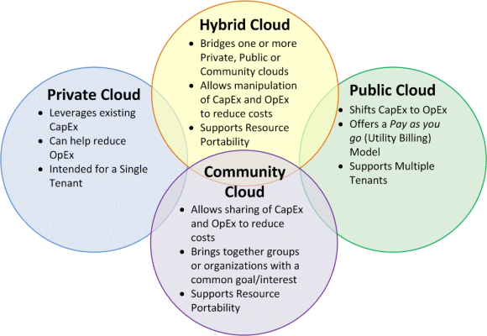
Service model
Saas
Paas
Iaas
Types
Deployment model
Public
Private
Hybrid
Community

Slide 6
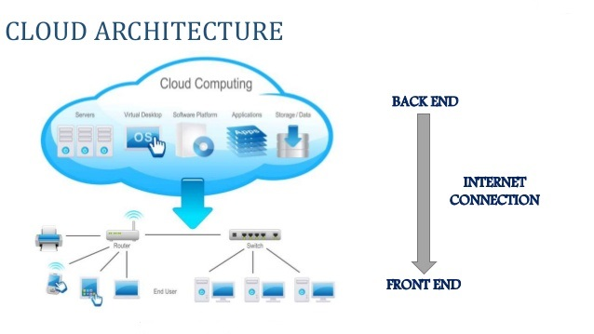
Cloud Computing Architecture
Two components
Front-End Back-End
Interface Browser Server Storage Security
Mechanism
Notes:
6

Slide 7
Security Issues and Risks
Issues
Data location
Data segregation
Long term viability
Recovery
Privilege user access of user.
Risks
Security of data in transit.
Security of data at rest.
Cloud legal & regulatory issues.
Robust separation of data.
Authentication
Notes:
7

Slide 8
Literature Review-Paper1
Achieving Secure, Scalable, and Fine-grained Data Access Control in Cloud Computing
Shucheng Yu∗, Cong Wang†, Kui Ren† , and Wenjing Lou∗
∗Dept. of ECE, Worcester Polytechnic Institute, Email: {yscheng, wjlou}@ece.wpi.edu
†Dept. of ECE, Illinois Institute of Technology, Email: {cong, kren}@ece.iit.edu
Idea:
Users choose cloud to store and protect their data, which in turn utilizes cloud servers for this purpose.
In order to protect the data from unauthorised servers, this technique is being propose
Demerits :
Time-complexity is one of the major demerits.

Slide 9
Literature Review – Paper 2
Implementation and Analysis of
Homomorphic Encryption Schemes
Nitin Jain1, Saibal K. Pal2& Dhananjay K. Upadhyay2
1USIT, Guru Gobind Singh Indraprastha University, Delhi – 110 075 INDIA,
garg.nitin007@gmail.com
Idea :
It is an analysis about Fully Homomorphic Encryption .
In this, the data to be stored is encrypted and sent to the cloud. The cipher text of the encrypted data is again encrypted in order to provide improved security to the data.
Demerits :
It is not suitable for encryption of huge amount of data.
It is a complex encryption scheme which requires large number of homomorphic keys.

Slide 10
Literature Review – Paper 3
Data Security and Privacy using Data Partition and Centric key management in Cloud
Mr. Krunal Patel M.Tech CSE-SCSE Vellore Institute of Technology Vellore, India
Idea :
The infrastructure in Iaas model of cloud provides scale based on user demand.
In order to reduce the complexity in providing security to large data, it makes partitions and provides individual security to each partition.
It also uses centric key management scheme.
Demerits :
Centric key management fragments the data due to which more memory is used.

Slide 11
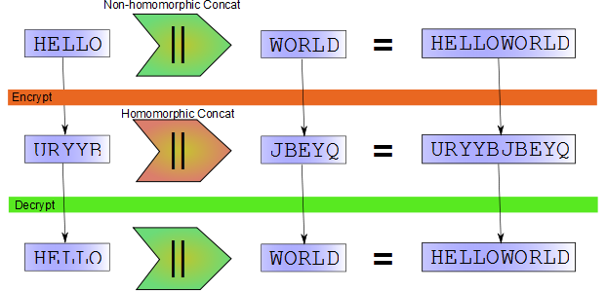
Homomorphic Encryption
The process of performing complex computations on encrypted data .
Data to be stored in cloud is encrypted and stored as cipher text.
The cipher text is encrypted without affecting it’s structure and characteristics.
It provides better security for the data.

Slide 12
Advantages
Distributed approach for key management unlike existing centralized technique.
fault tolerant to the byzantine attack, server colluding attacks and Data modification.
Increased system reliability by Voting technique
Voting technique prevents the modification of share by attackers.
The shares are renewed after a pre-decided crypto time to ensure data security.
Notes:
12

Slide 13
Proposed Technique
Entities in Proposed technique:
Cloud user
Cloud Storage server
Cloud manager
Key Splitter server
Shareholder server
Security server
Log editor
Homomorphic Encryption Algorithm is used to protect these entities.
Notes:
13

Slide 14
Algorithm
Encryption method :
Split the letter of modified plaintext.
Assign the position(i) of the letter.
Generate ASCII value of the plaintext.
E=(P+K+I) P-plaintext, K-key, i-position.
Generate ASCII character for E to get Ciphertext.
Apply Homomorphic Encryption on Ciphertext.
Notes:
14

Slide 15
Algorithm
Decryption Method :
Decipher value to get the Ciphertext.
Generate the ASCII Value for the Ciphertext.
Same Encryption Key is used.
Assign the position(i) for the Ciphertext.
D=((P-K-i)) P-plaintext, K-Key, i-position.
Generate the ASCII character for D.
D tends to be the plain text.
Notes:
15

Slide 16
KEY MANAGEMENT
Key management is major technique which is used to secure encryption key.
Key management is

Slide 17
Proposed Model
File Upload :
User Request to Upload a file in the Cloud.
Cloud Encrypt the file and sends the file to Cloud Storage.
After that Key splitter splits the key.
The secondary is sent to Key manager.
And master Key is sent to User.
Then Key manager shares the key among the Shareholders.
Notes:
17

Slide 18
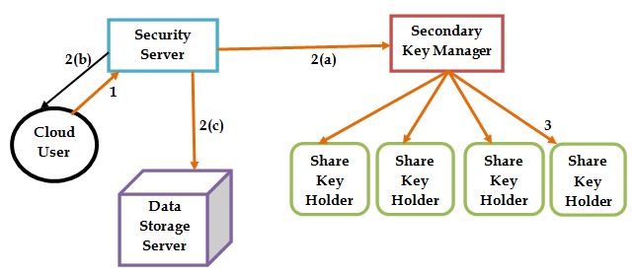
File Upload
Notes:
18

Slide 19
Proposed Model
File Download:
Request to Security server for downloading file.
Request to user to provide the master Key.
Data server Storage sends the encrypted file to the security server.
Security server inquiries the Secondary Key from the Key manager.
Key manager request the share from different Shareholder.
After shareholder sends the share to the key manager it combines it.
Security server combines both the keys and decrypt the file and send file to the user.
Notes:
19

Slide 20
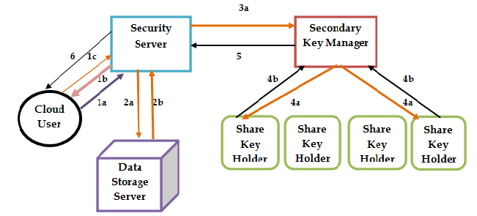
File Download
Notes:
20

Slide 21
Conclusion
Key management is the toughest part of managing in cryptosystems.
In the cloud, there is always a possibility of an insider attack or outsider attack.
Keys can be accessed or stolen by employees without the knowledge of end users.
Our proposed technique provides security to the data as well as Key.
This technique also provides better security against byzantine failure, server clouding, and data modification attacks.
Notes:
21

Slide 22
Future Work
In future, this work can be extended to use some other secret sharing schemes which are more efficient so that the performance of proposed system can be further improved. In addition to this, the proposed technique can be extended to work with asymmetric encryption algorithms.
Notes:
22

Slide 23
References
Mell, Peter, and Timothy Grance. "The NIST definition of cloud computing (draft)." NIST special publication 800.145 (2011): 7.
Ogbu,Richard Chukwu, and Ifeanyi Ugbaga Nkole.”Cloud Computing: A Review”
Shamir, Adi. "How to share a secret." Communications of the ACM 22.11 (1979): 612-613.
Kalyani M .”Cloud Security:Efficient and Reliable Encryption Key management Crucial for Data Protection”.
Blakely, George Robert.”Safeguarding Cryptographic Key”.Managing Requirements knowledge,International Workshop on IEEE Computer Society,1899.
Notes:
23

